Slide 1
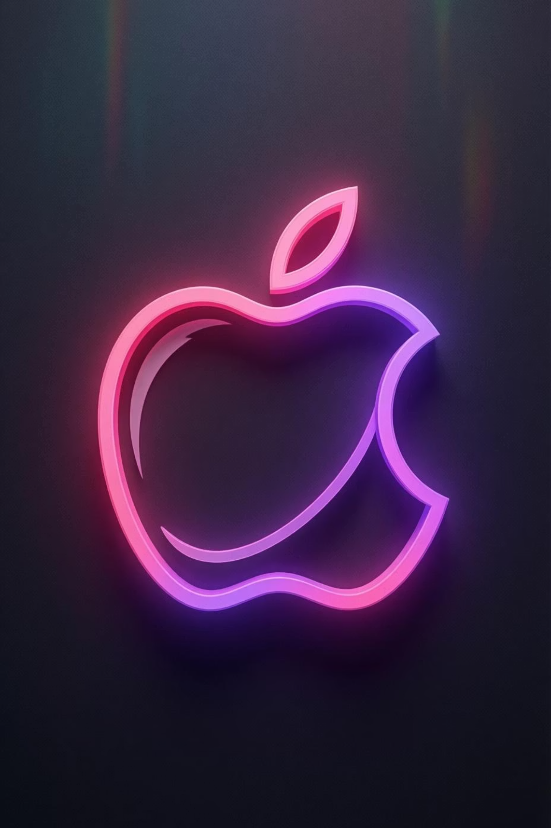
Apple Inc.: From Garage Start-up to Global Tech Giant
A journey of innovation, resilience, and visionary thinking that transformed the technology landscape forever

Slide 2


1976
The Humble Beginning: 1976 Garage Founding
Steve Jobs, Steve Wozniak, and Ronald Wayne founded Apple Computer on 1st April 1976 in Jobs' family garage in Cupertino, California. This modest beginning would spark a technological revolution.
The venture was funded by selling personal possessions: Jobs sold his Volkswagen van whilst Wozniak parted with his beloved HP calculator. Their first creation, the Apple I, was a hand-built personal computer kit that laid the groundwork for everything to come.

Slide 3
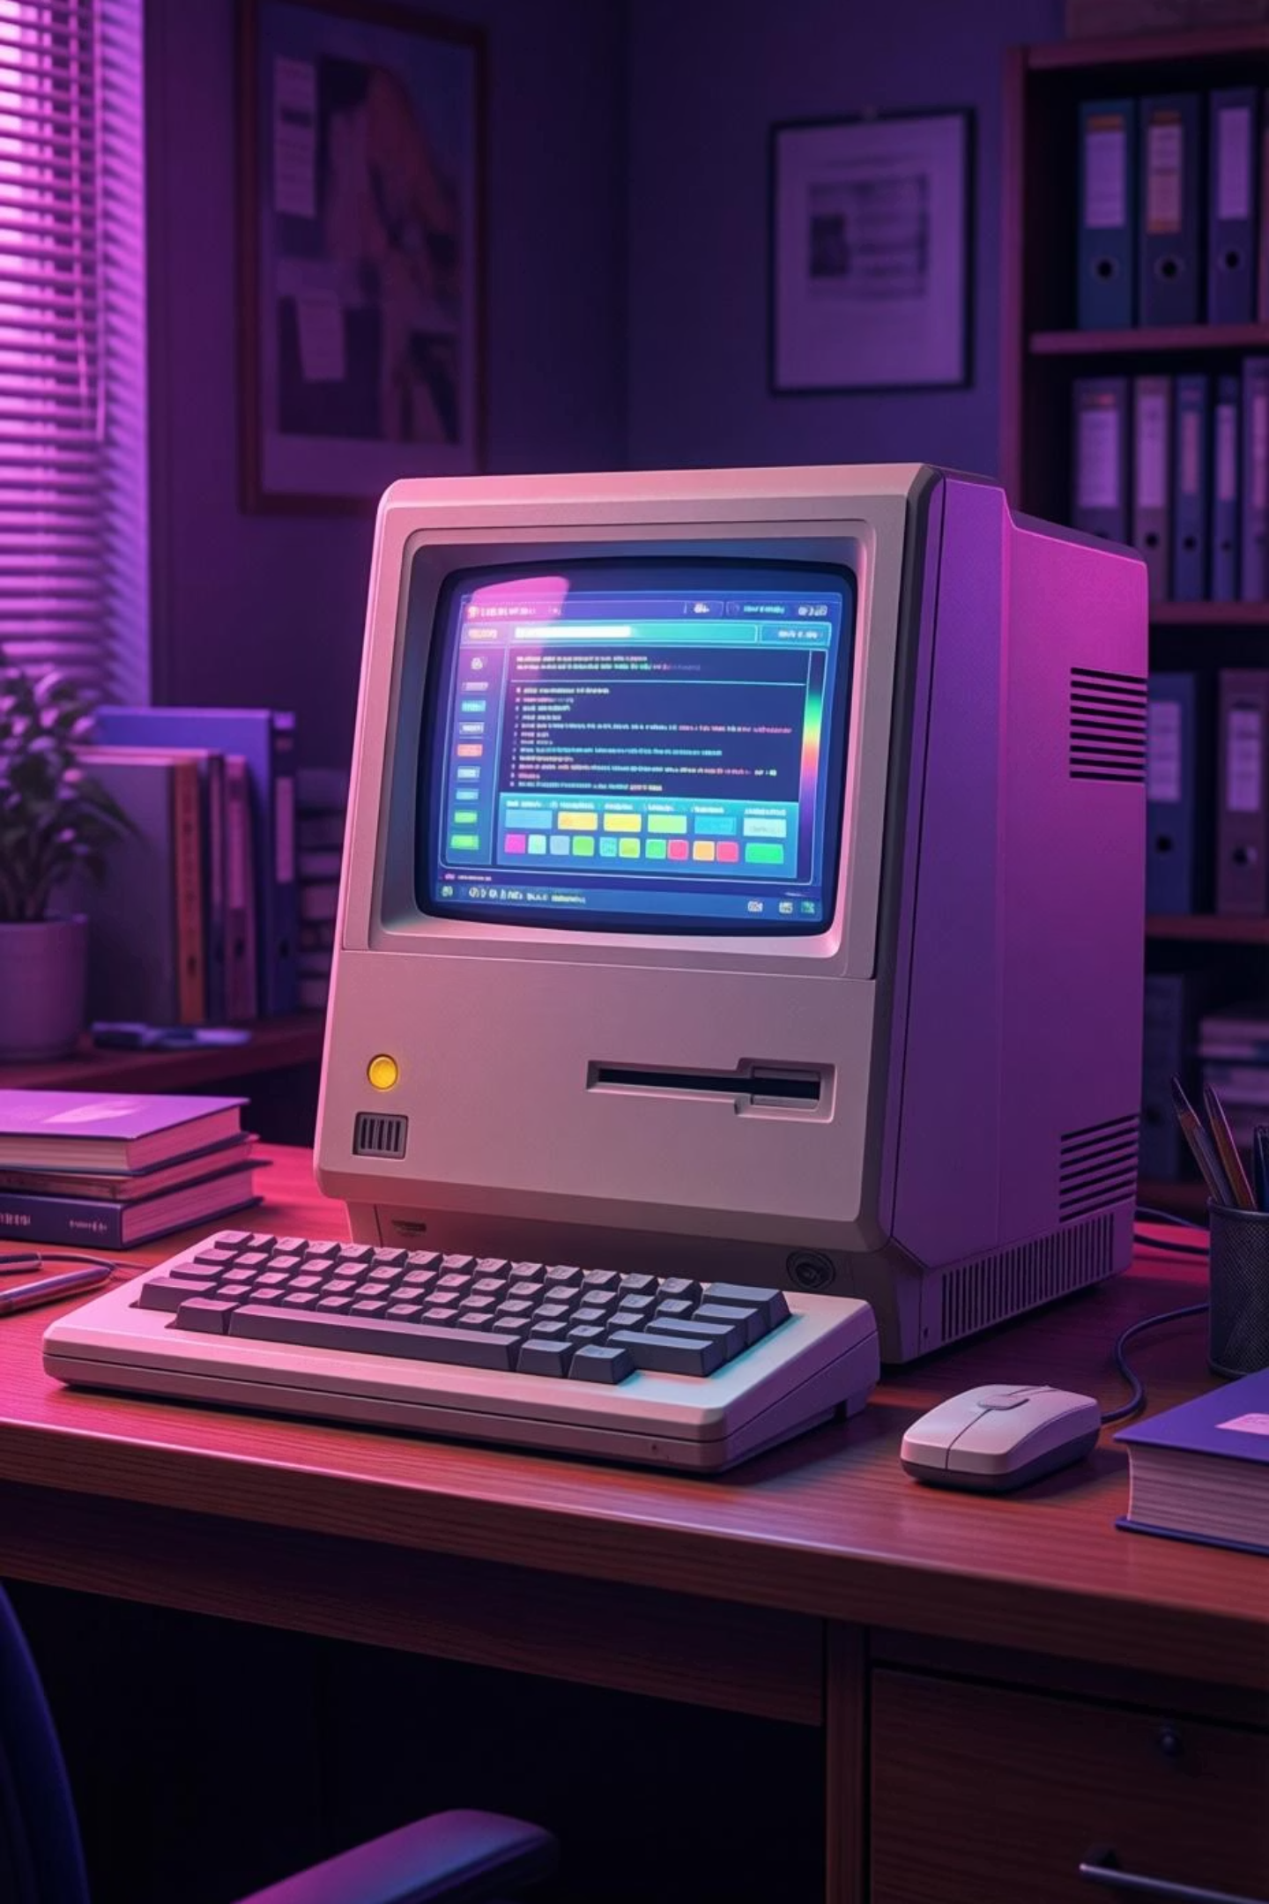
BREAKTHROUGH
Apple II: The Computer That Changed Everything
Colour Graphics Pioneer
Market Success
Education Leader
Became one of the first highly successful mass-produced microcomputers in history
Achieved remarkable early success in education and small business markets worldwide
Revolutionary colour display capabilities and open architecture design that invited innovation

Slide 4

1984
The Macintosh Revolution
A New Era of Computing
Launched with the iconic "1984" Super Bowl commercial directed by Ridley Scott, the Macintosh introduced the world to personal computing as we know it today.
It was the first personal computer featuring a graphical user interface (GUI) and mouse, making technology accessible to everyone—not just programmers and enthusiasts.
The Macintosh set entirely new standards for user-friendly computing and elegant design.

Slide 5

The Dark Years and Jobs' Departure
1
1985: Jobs Leaves
Internal power struggles and boardroom conflicts led to Steve Jobs' dramatic departure from the company he co-founded
2
1990s: Struggling
Apple faced a series of product failures, declining market share, and mounting financial difficulties
3
1997: Near Collapse
The company teetered on the brink of bankruptcy, desperately needing new direction and innovation

Slide 6

THE RETURN
Steve Jobs Returns and the iMac Revolution
A Triumphant Comeback
Jobs returned to Apple after the company acquired his new venture, NeXT, in 1997. It was a homecoming that would save the company and reshape the entire technology industry.
In 1998, he introduced the colourful, translucent, all-in-one iMac—a bold statement that revitalised Apple's brand identity. The iMac marked the beginning of Apple's unwavering focus on sleek, minimalist design and seamlessly integrated hardware-software experiences.

Slide 7
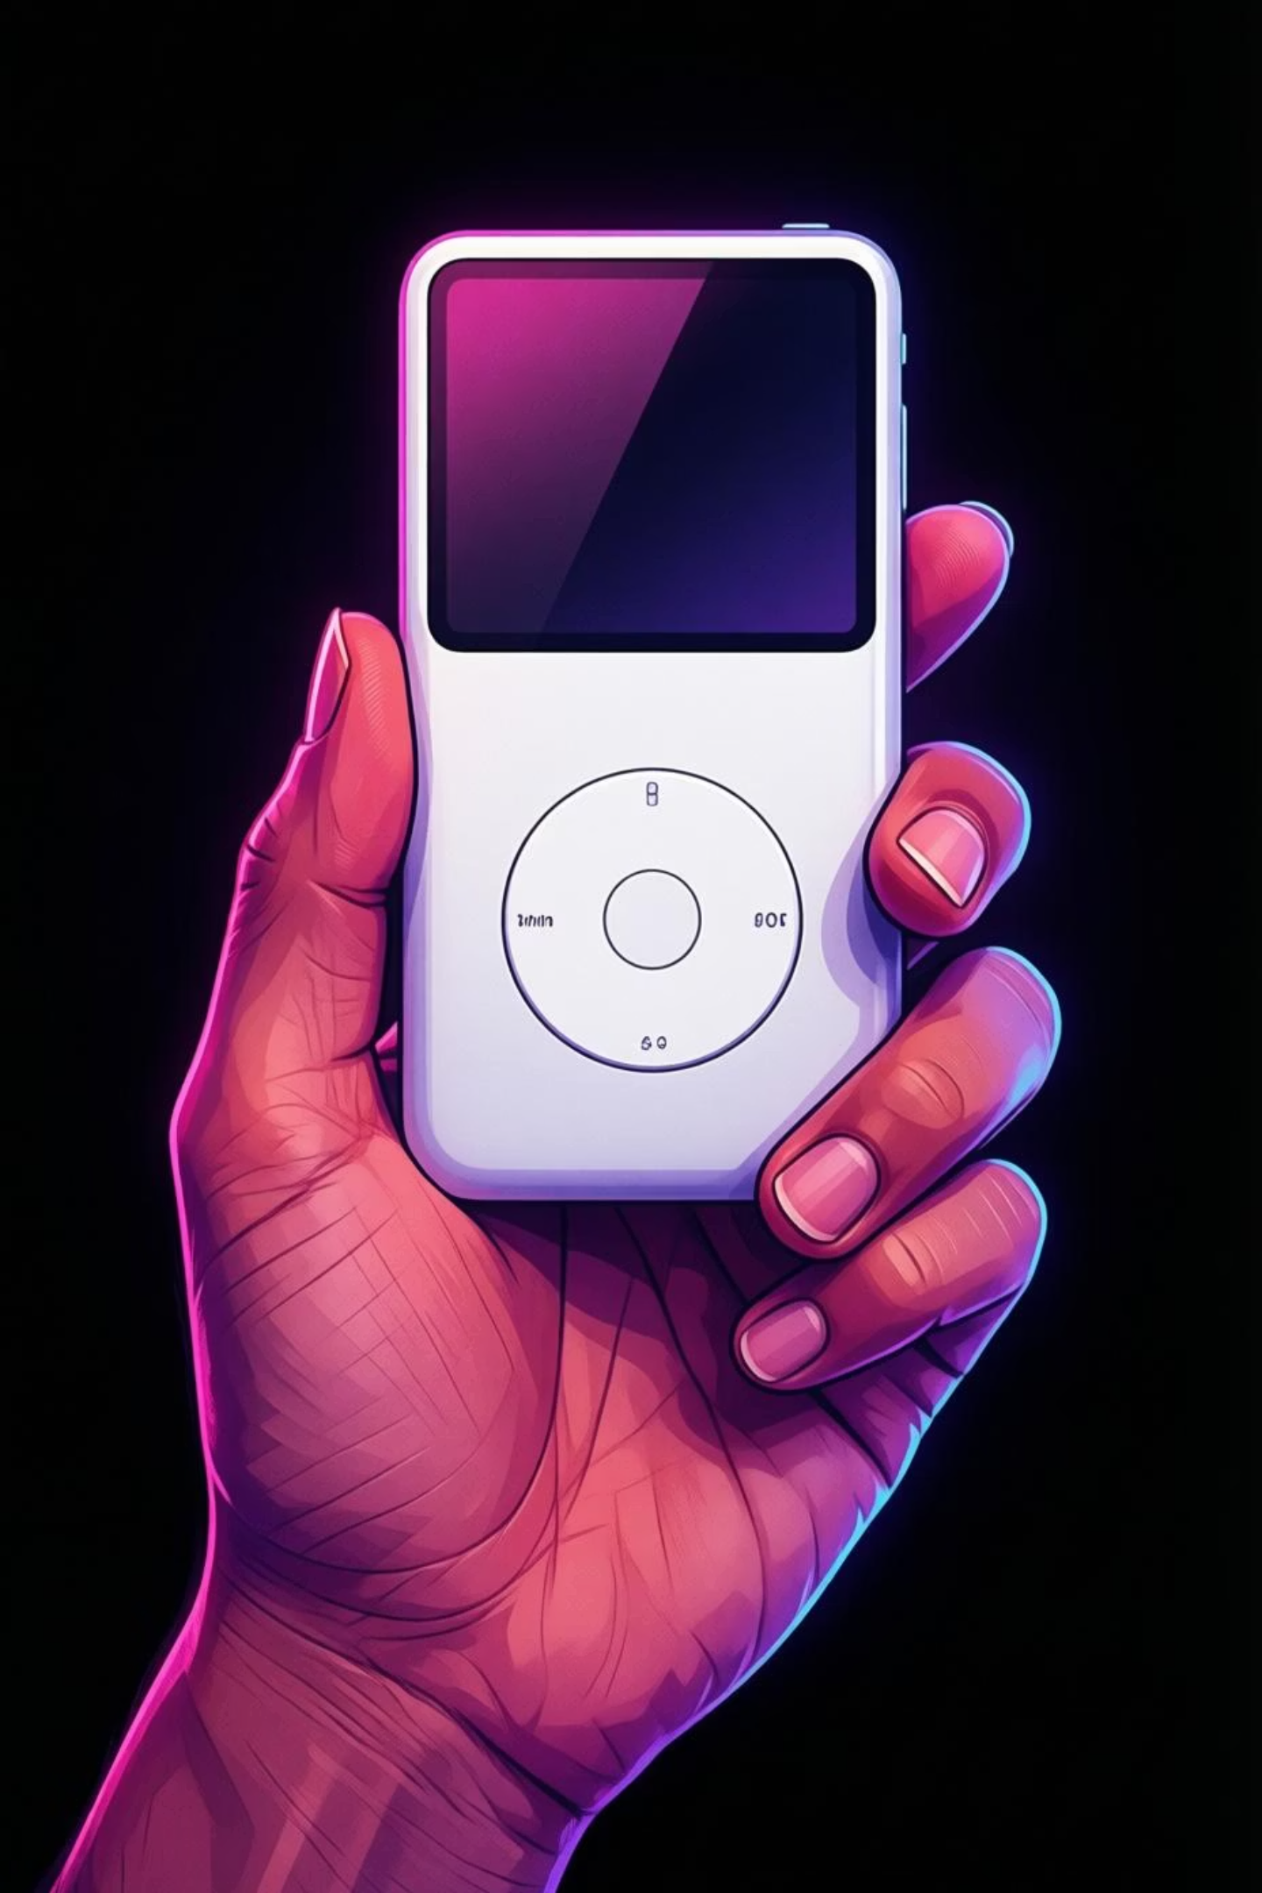


The iPod and iTunes: Disrupting the Music Industry
01
02
iPod Launch (2001)
iTunes Store (2003)
Revolutionised portable music with its elegant interface, massive storage capacity, and the promise of "1,000 songs in your pocket"
Pioneered legal digital music sales, transforming how people discovered, purchased, and enjoyed music worldwide
03
Beyond Computers
Established Apple as a dominant force in consumer electronics, expanding far beyond its computer origins

Slide 8
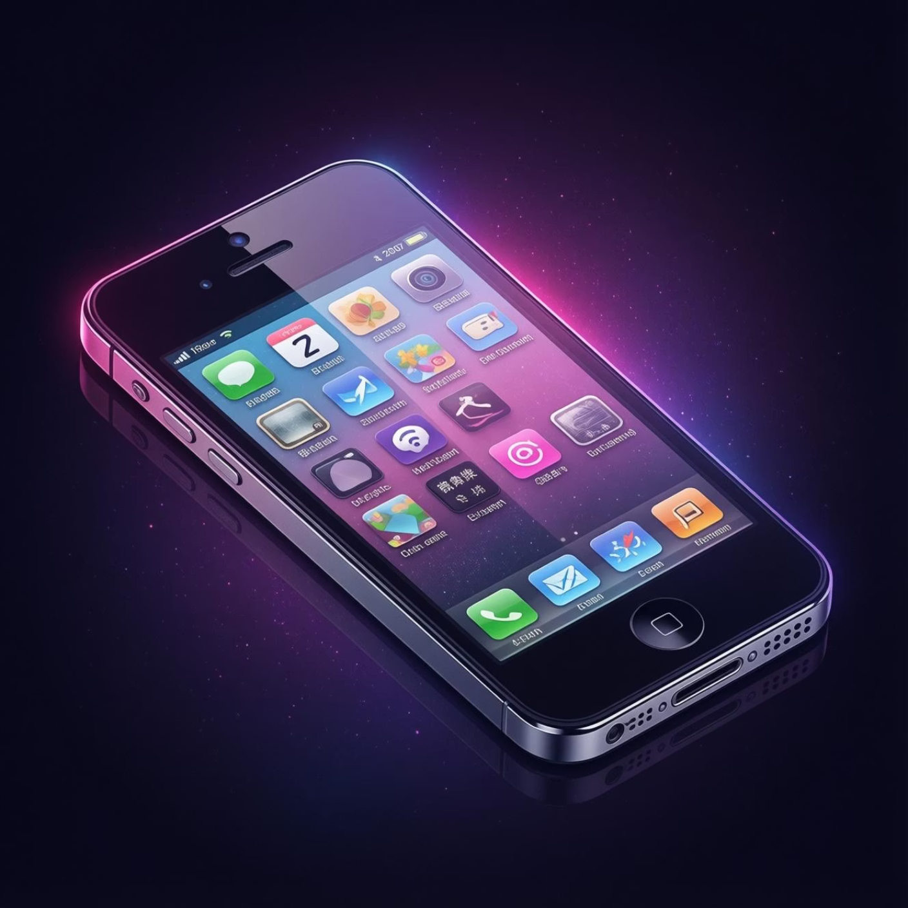

GAME CHANGER
The iPhone Era: Redefining Mobile Technology
Three Devices, One Revolution
Introduced in 2007, the iPhone brilliantly combined a mobile phone, iPod, and internet device into one revolutionary product.
Multi-Touch Interface
Introduced intuitive gesture controls that made technology feel natural
App Store Ecosystem
Created an entirely new economy for developers and transformed software distribution
Industry Transformation
Sparked the smartphone revolution, reshaping communications, entertainment, and commerce globally

Slide 9
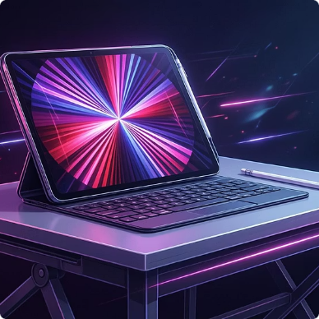
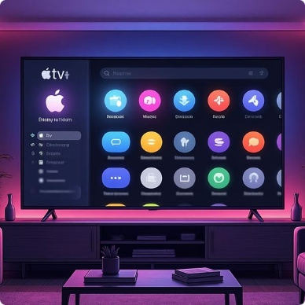

Apple Today: Innovation and Market Leadership
$3T
2B+
100%
Market Valuation
Active Devices
Carbon Neutral
World's most valuable company as of 2026
Installed base worldwide across all products
Commitment to environmental sustainability by 2030
Expanding Ecosystem
Services Growth
Privacy First
Apple TV+, Apple Music, iCloud, and Apple Pay drive recurring revenue
Leading industry commitment to user privacy and data security
iPad, Apple Watch, AirPods, and Apple Silicon Macs continue pushing boundaries

Slide 10

The Legacy of Apple: Innovation, Design, and Culture
Enduring Vision
Seamless Ecosystem
Global Influence
Steve Jobs' philosophy of simplicity, elegance, and user-centric design continues to drive every Apple innovation
Apple's integrated approach creates fluid, intuitive experiences that connect billions of users worldwide
Inspires innovation across technology, design, and business, setting standards that competitors follow
The story of Apple is a testament to creativity, resilience, and visionary thinking—proving that with passion and perseverance, even a garage start-up can change the world.

